Slide 1
Index position of pattern in string
By : Nikita Tambe (36075)

Slide 2

MSPM’S
DEOGIRI INSTIUTE OF ENGINEERING AND MANAGEMENT STUDIES, Aurangabad
Academic year 2019-20
Department Of Computer Science And Engineering
Subject : Theory of Computation
Topic : Index position of pattern in string
Github link : nikitatambe2000
Submitted By
Nikita Dnyaneshwar Tambe(36075)
Under the Guidance of:
Dr. S. M. Chavan
Asst.Prof.Department of CSE
(DEOGIRI INSTIUTE OF ENGINEERING AND MANAGEMENT STUDIES)

Slide 3
Introduction
Pattern searching is an important problem in computer science.
When we do search for a string in notepad/word file or browser or database, pattern searching algorithms are used to show the search results.

Slide 4
Finite Automata
In FA based algorithm, we preprocess the pattern and build a 2D array that represents a Finite Automata.
we simply need to start from the first state of the automata and the first character of the text.
At every step, we consider next character of text, look for the next state in the built FA and move to a new state. If we reach the final state, then the pattern is found in the text.
The time complexity of the search process is O(n).

Slide 5
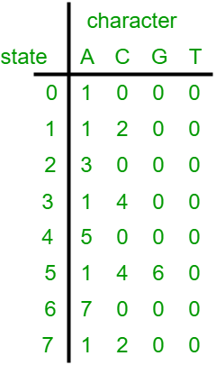
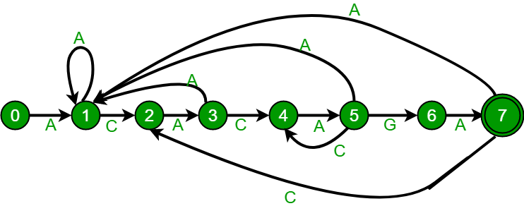
FA for pattern ACACAGA.

Slide 6
Applications
Text Searching
Pattern Recognition
Complier Design
Contact Searching

Slide 7
Conclusion
The pattern searching in a string very useful for the different applications.
With the help of the pattern searching we can do the tasks very easily.

Slide 8
THANK YOU

